Slide 1
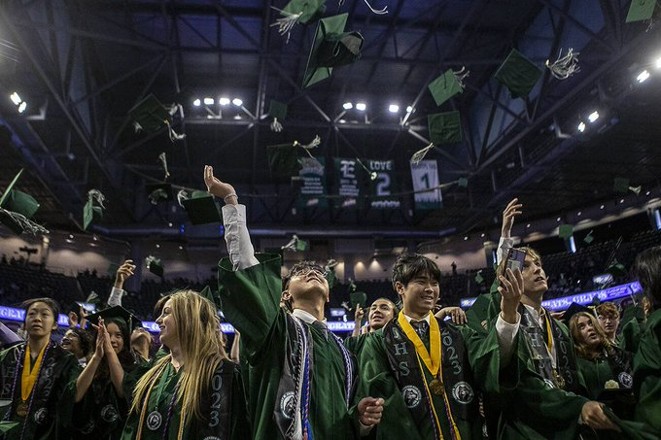

Counselor Meeting
CCR Updates
EVERETT PUBLIC SCHOOLS
September 28, 2023

Slide 2
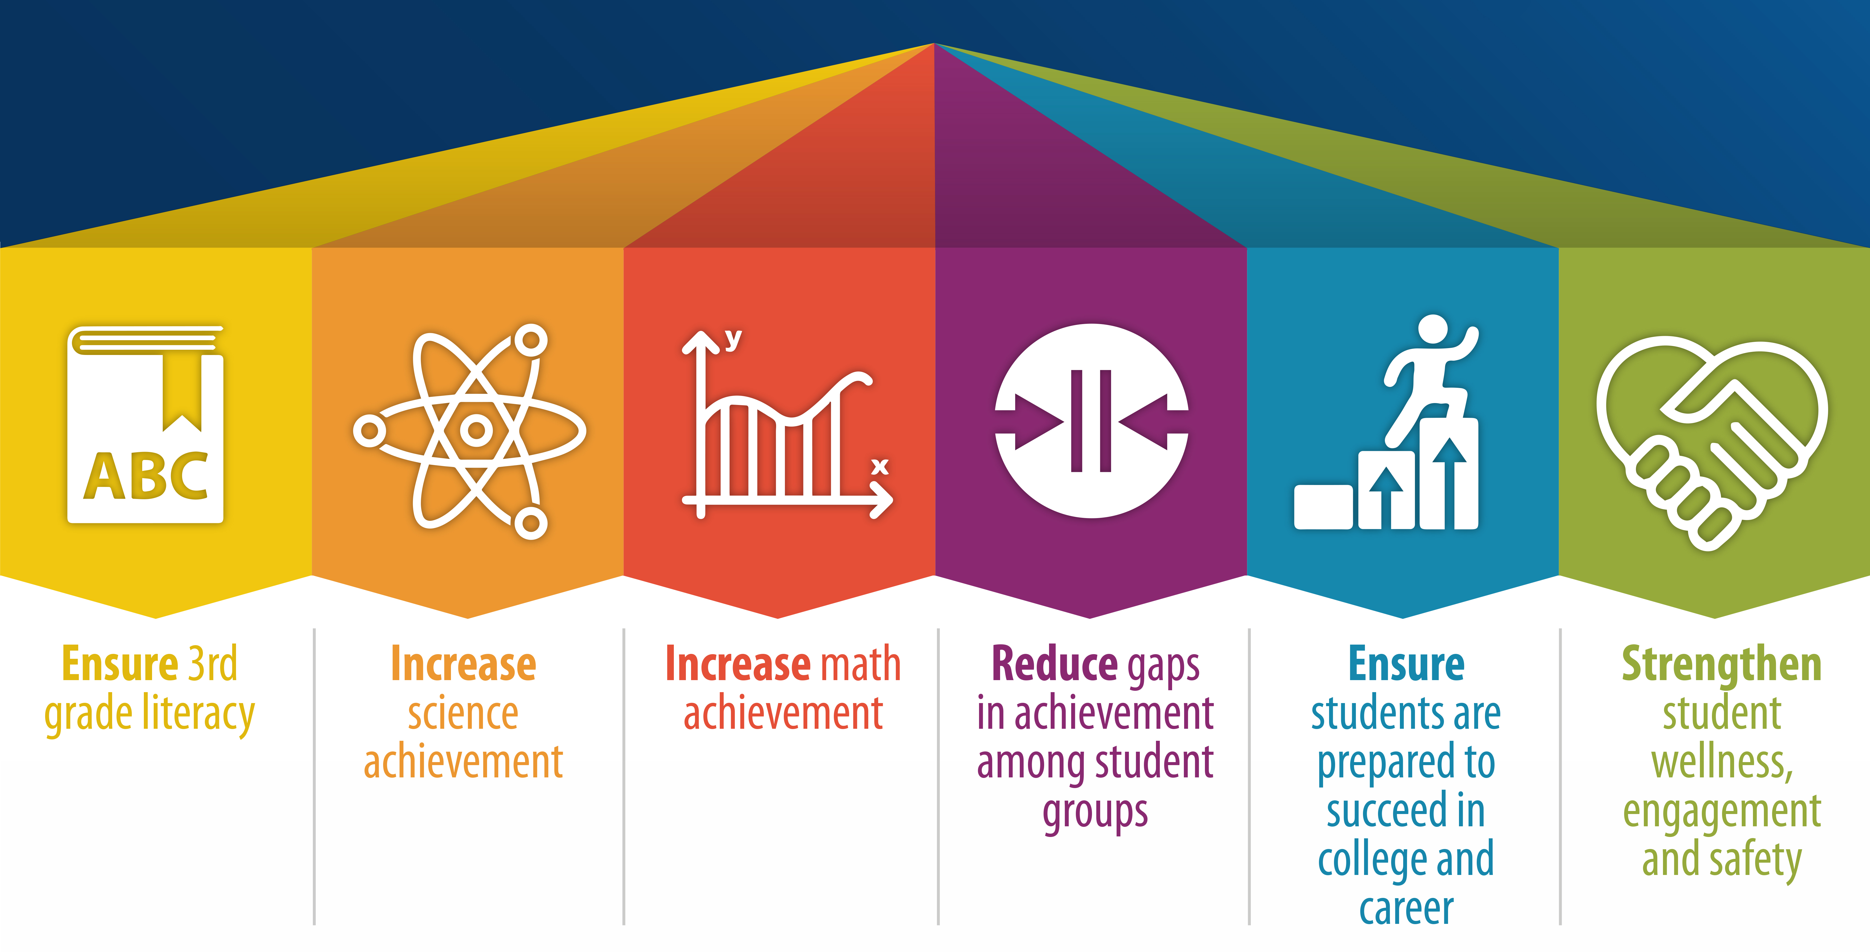

Strategic Plan Priority Student Outcomes

Slide 3
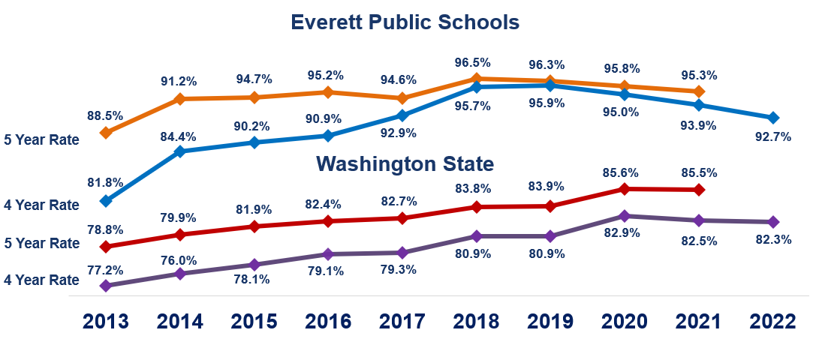
Graduation Rates, Classes of 2013 – 2022
OSPI Report Card

Slide 4









What are the graduation requirements?
High School & Beyond Plan
Each year through Naviance, starting in sixth grade
Culminates in College and Career Readiness Seminar
Includes high school and postsecondary planning
Credit & Subject Area Requirements
17 core credits
3 Personalized Pathway Requirements (flexible credits)
4 elective credits, including College and Career Readiness Seminar
Graduation Pathway Options
Options to demonstrate postsecondary readiness in English Language Arts and Math through tests and courses

Slide 5
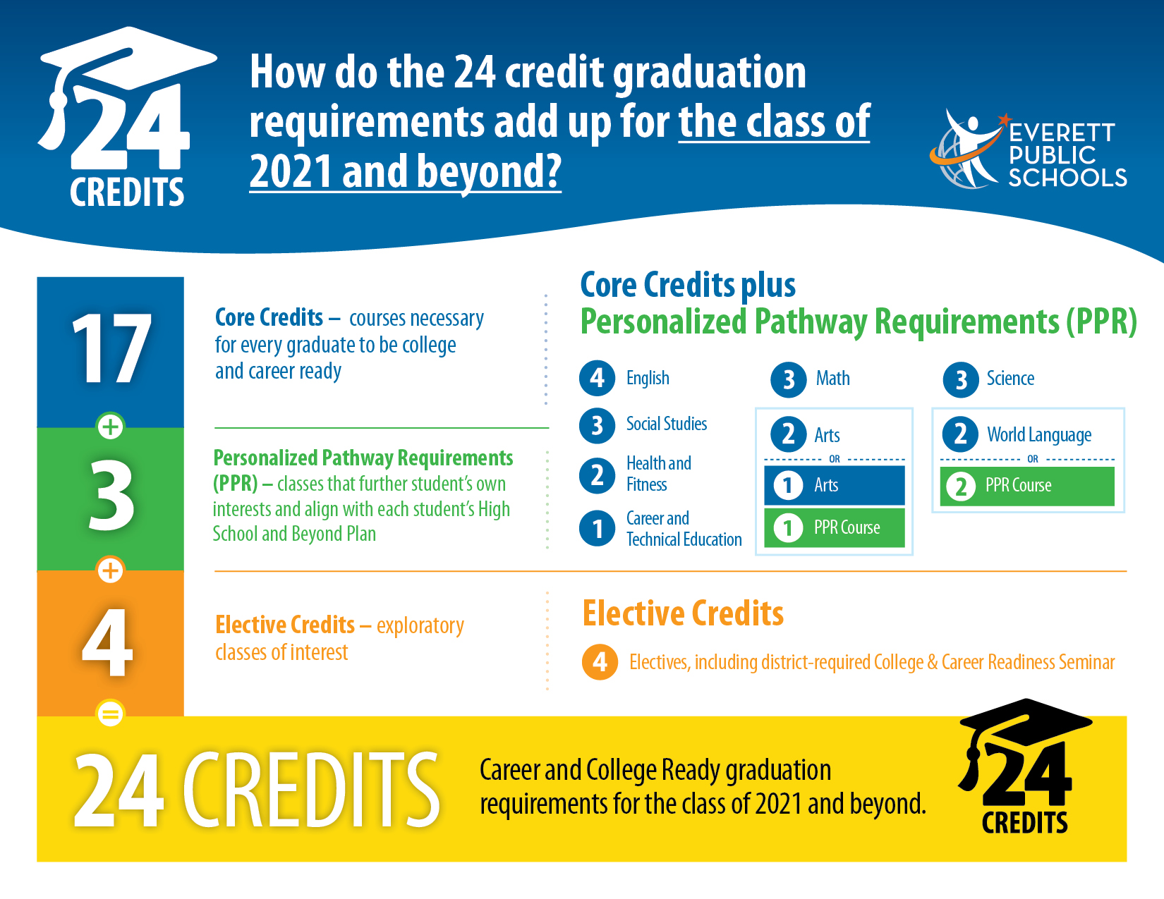
What are the graduation requirements?

Slide 6
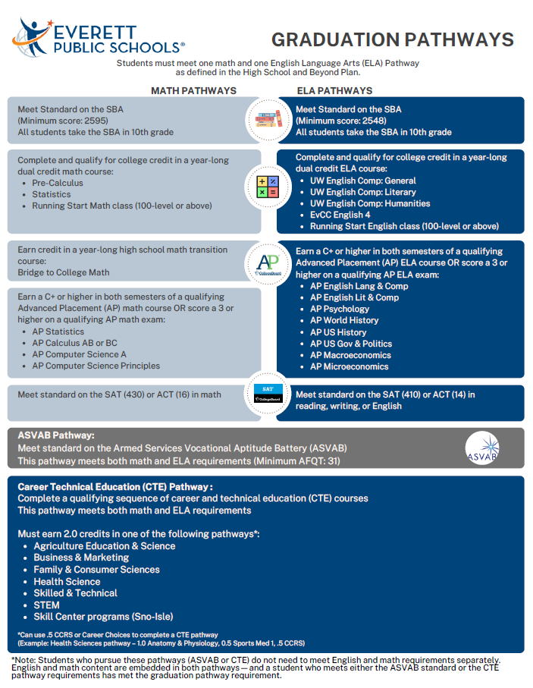
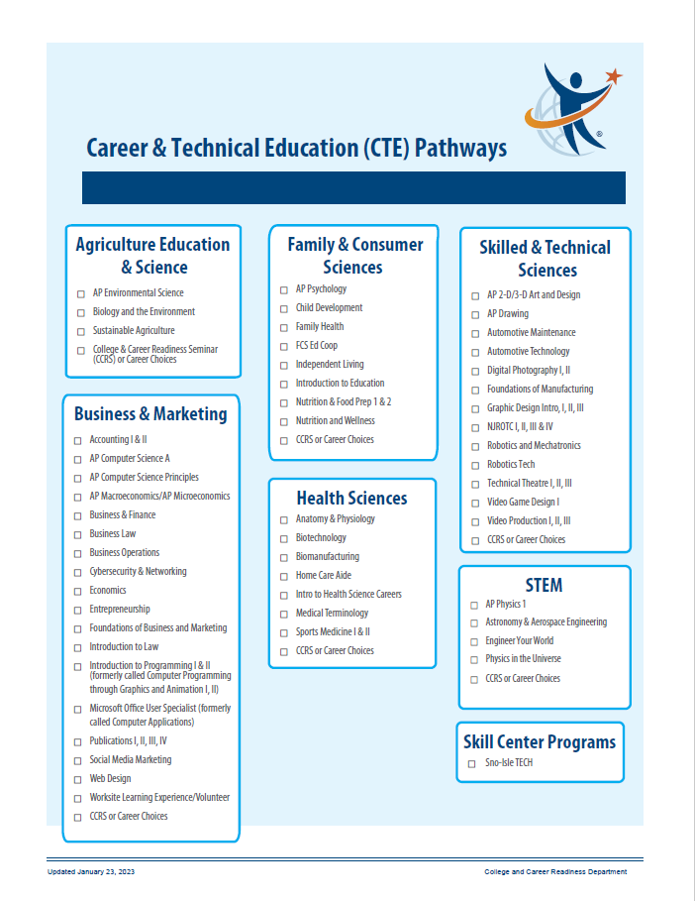
What are the graduation pathways?
State assessment – Smarter Balanced Assessments, WA-AIM
Dual credit courses – AP, College in the High School, CTE Dual Credit and Running Start
AP exams
College entrance exams – SAT
Transition courses – Bridge to College Math
CTE Pathway – Specific sequence of CTE courses
Armed Services Vocational Aptitude Battery (ASVAB)
Coming Soon! Performance-based Pathway

Slide 7
Waivers Available for the 2023-24 School Year
There are two types of waivers available for students graduating in the 2023-24 school year:
GREW Waiver: Up to one core credit may be waived
Academic Waiver: Up to two elective credits may be waived
There is not a waiver available for the Graduation Pathway for the 2023-24 school year.

Slide 8
Graduation Requirements for Students with IEPs
IEP teams are not able to create new graduation pathways nor to waive graduation requirements for students receiving special education services.
To support students with disabilities in meeting graduation requirements, IEP teams may utilize comparable content course substitutions, as identified in the IEP course of study and aligned with the student’s High School and Beyond Plan.
State Board of Education Graduation Requirements

Slide 9
Everett Reengagement Academy
Everett Reengagement Academy is our district’s Open Doors 1418 Youth Reengagement high school. There are two programs within Everett Reengagement Academy:
  Graduation Alliance Everett
  Everett Community College U3 Program
The purpose of Open Doors programming is to provide a high school diploma option for students 16 – 21 years old (16 by September 1) who are not enrolled in high school, who are not on track to graduate, and/or who may not complete high school without intensive supports.
Students enrolled in Everett Reengagement Academy are confirmed transfers, even though they are served through the district.

Slide 10
Guaranteed Admission Program
 | Public Schools | Pacific Lutheran | Saint Martin’s
Cascade High School | 139 | 107 | 139
Everett High School | 118 | 91 | 118
H.M. Jackson High School | 300 | 246 | 300
Sequoia High School | 3 | 2 | 3
 | 560 | 446 | 560
Guaranteed Admission Program

Slide 11
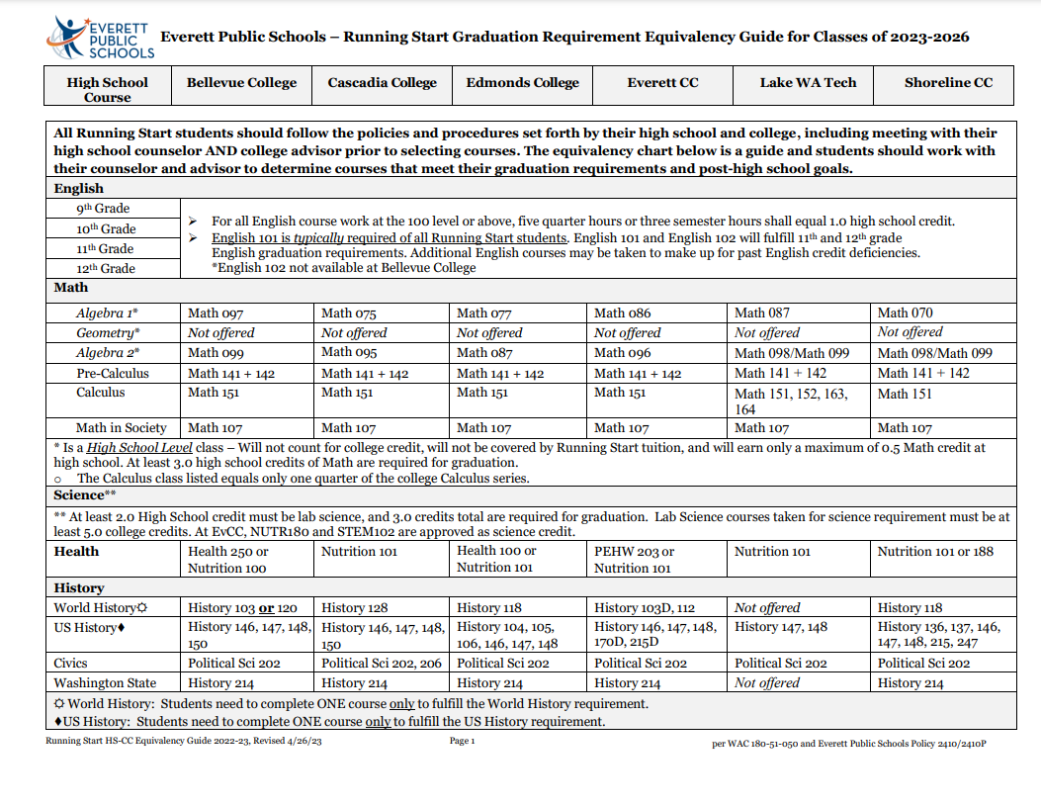
Running Start
All Running Start students are required to complete the High School & Beyond Plan tasks, including completing their Senior Survey and uploading a current resume in Naviance
Running Start students not seeking an Everett Public Schools diploma should be referred to Sequoia/Port Gardner

Slide 12

Questions?

